Slide 1
Redesigning Craigslist Housing
UX Case Study

Slide 2
The Problem
Company
Context
Problem statement
People frequently use Craigslist to search for housing, but many struggle to quickly find listings that meet their needs due to the platform’s outdated interface, limited filtering options, and inconsistent listing information. The goal of this redesign is to help users browse housing listings more efficiently, compare options easily, and identify trustworthy listings so they can make housing decisions with greater confidence while saving time during the search process.

Slide 3
Objectives & Goals
Create an easy-to-use housing search experience that helps users feel confident when browsing and evaluating listings on Craigslist.
Allow users to quickly find housing listings that match their needs through clearer organization and improved filtering options.
Help users easily compare listings by presenting important details, such as price, location, and amenities, in a clear and consistent way.
Improve user safety by introducing clearer listing information and potential verification features that help users identify more trustworthy posts and avoid scams.
Support users in saving and revisiting listings so they can keep track of potential housing options and make decisions more efficiently.

Slide 4
The Process
Discover
Define
Design
Direct Competitor Analysis’
Indirect Competitor Analysis’
User Interviews
User Personas
User Flows
Early Sketches
Style Guide
High Fidelity Screens
Final Iteration

Slide 5
Discover
Competitive Research
& User Interviews

Slide 6
Direct Competitor Analysis
Zillow
“Let’s get you home.”
Features:
Advanced Filters: Users can search by price, bedrooms, location, amenities, and more.
Map-Based Search: Interactive map allows users to browse homes by geographic area.
Detailed Listings: Listings typically include photos, descriptions, pricing history, and property details.
Saved Searches & Alerts: Users can save listings and receive notifications for new properties.
Issues:
Limited Direct Communication: Messaging landlords or agents can be less immediate than marketplace-style platforms.
Higher Listing Barriers: Many listings come from agents or property managers, limiting casual or informal postings.
Information Overload: Large amounts of property data can feel overwhelming to some users.
Not Fully Local/Community-Based: Less focused on peer-to-peer local postings compared to Craigslist.

Slide 7
Direct Competitor Analysis
Facebook Marketplace
“Meta. Metamates. Me.”
Features:
User Profiles: Listings are connected to Facebook accounts, helping users view seller identities.
Built-in Messaging: Users can contact sellers instantly through Facebook Messenger.
Visual Layout: Image-focused listing grid makes browsing quick and easy.
Location Filters: Users can search listings based on location and distance.
Issues:
Limited Housing Filters: Not optimized specifically for housing searches.
Inconsistent Listings: Information and quality vary depending on the poster.
Scam Risk: Some listings may still be misleading or fraudulent.
Mixed Categories: Housing listings appear alongside many unrelated marketplace items.

Slide 8
Indirect Competitor Analysis
Airbnb
“Belong Anywhere.”
Features:
Verified Host Profiles: Hosts have profiles, reviews, and ratings that help establish trust.
Review System: Guests can read previous reviews to evaluate properties before booking.
High-Quality Photos: Listings typically include multiple professional or detailed images.
Clear Booking Process: Structured booking and payment system built into the platform.
Issues:
Short-Term Focus: Most listings are designed for temporary stays rather than long-term housing.
Higher Costs: Service fees and nightly pricing can make it more expensive than traditional rentals.
Limited Long-Term Options: Fewer listings suited for permanent housing searches.
Strict Booking Structure: Less flexibility compared to direct landlord communication.

Slide 9
Indirect Competitor Analysis
Next Door
“Home is more than an address.”
Features:
Neighborhood-Based Network: Users connect with verified neighbors in their local area.
Community Posts: Residents can share housing leads, rentals, or roommate opportunities.
Local Recommendations: Users can ask neighbors for housing suggestions or landlord referrals.
Verified Location: Accounts are tied to a real neighborhood, which can increase trust.
Issues:
Not Housing-Focused: Housing posts are mixed with general community discussions.
Limited Search Tools: Few filters or structured ways to browse available rentals.
Inconsistent Listings: Posts vary widely in detail, format, and availability.
Hard to Compare Options: Listings appear in feed-style posts rather than organized search results.

Slide 10
User Interviews
I conducted interviews with two participants, ages 27–34, to learn about their experiences searching for housing online, including the challenges they face when using platforms like Craigslist. The goal was to understand user behaviors, pain points, and needs in order to inform the redesign.
“Craigslist is probably my least favorite out of the three. It does the worst job of giving you additional options to filter through…”
Key Findings
● Filtering Matters Most
Users rely on advanced filters, school district, price, bedrooms/bathrooms, and location, to narrow listings efficiently. Limited filters on Craigslist drive users to competitors.
“I would make sure that there's more transparency… some of the listings are misleading, especially in apartment complexes. Clearer photos and structured information would make it much easier to browse.”
●Trust Comes from Visual & Professional Signals
Listings with photos, floor plans, detailed descriptions, and realtor/owner verification feel more credible. Inconsistent formatting on Craigslist lowers trust.
● Visual Browsing & Organization Improve Usability
A clean layout with thumbnail previews and standardized listing details allows faster browsing and better decision-making. Craigslist’s clutter slows searches and adds friction.
“Craigslist is chaotic… the housing section feels like an afterthought. You have to spend a lot of time going through each listing carefully.”

Slide 11
Define
Personas
& User Flows

Slide 12
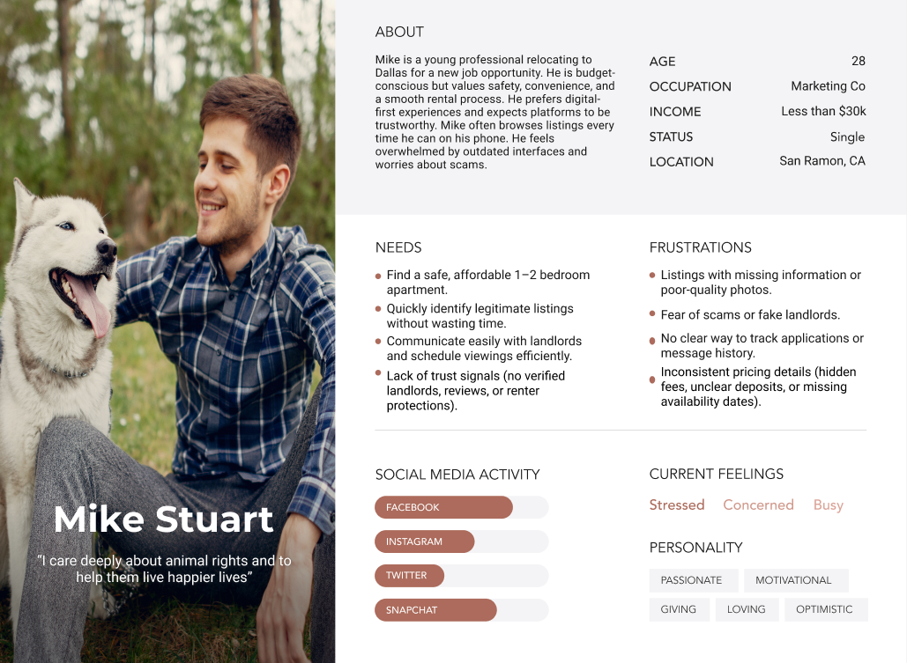
User Persona

Slide 13
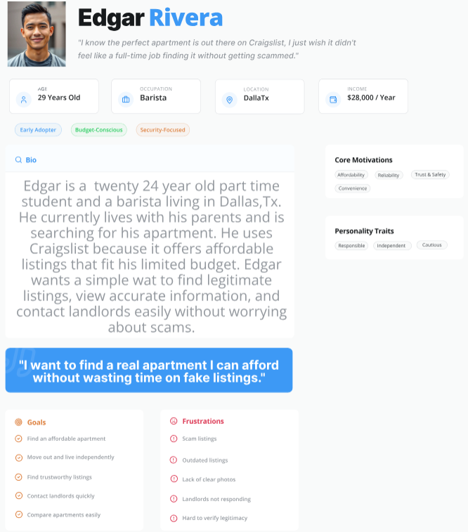
User
Persona

Slide 14
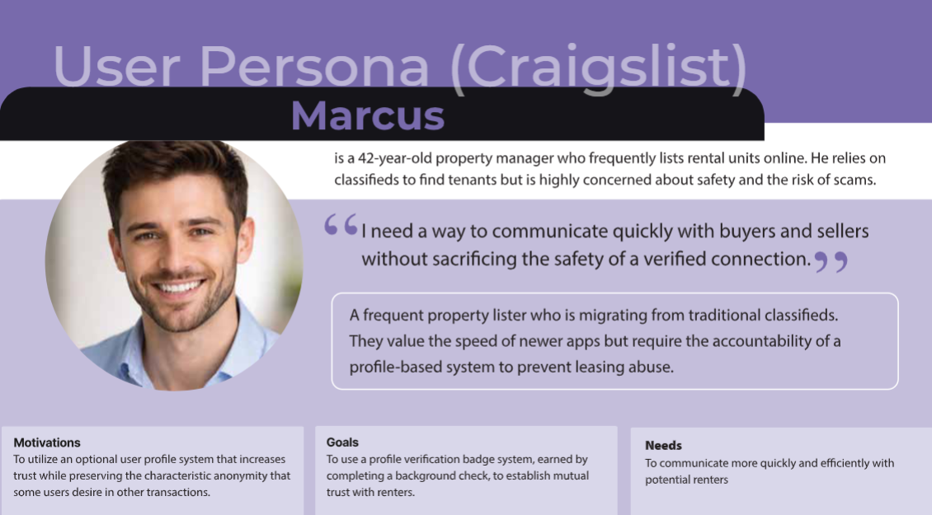
User Persona

Slide 15
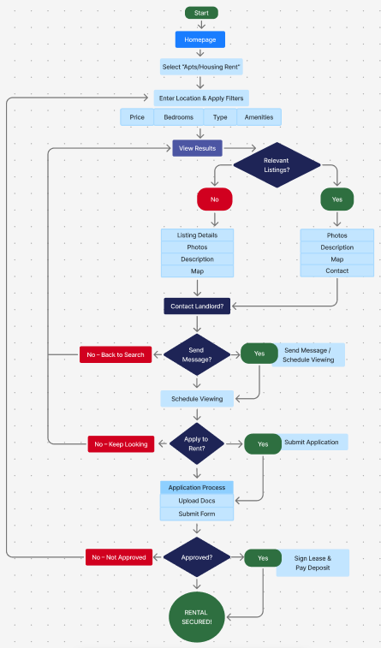
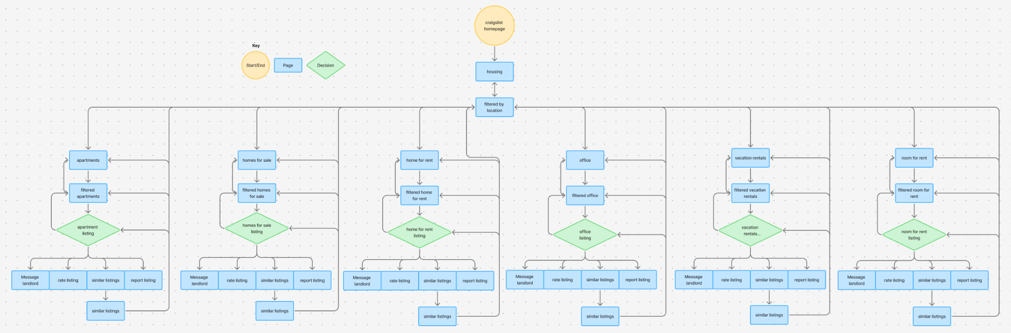
Renter User Flow
An in-depth mapping of the renter journey, capturing how users discover, explore, evaluate, and shortlist housing options. This flow highlights key interactions and touchpoints that shape a smooth and confident decision-making process.

Slide 16
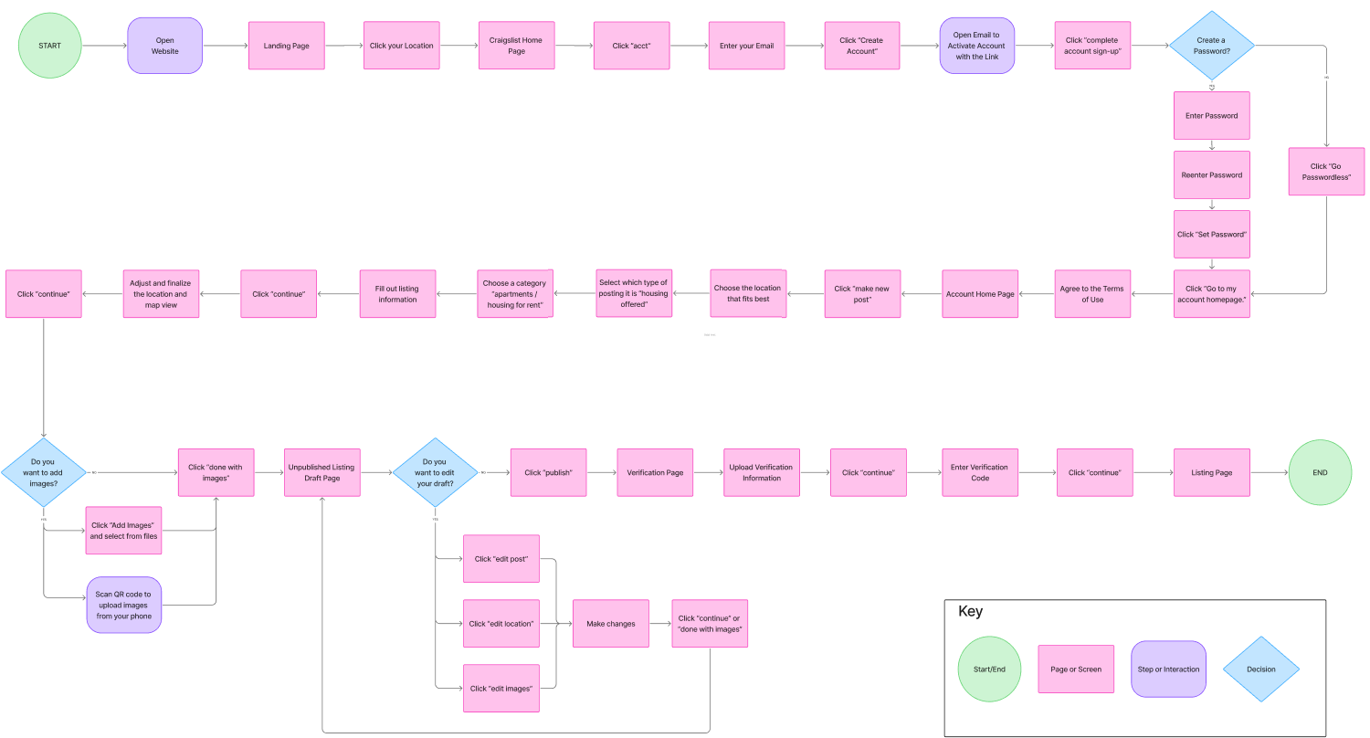
Landlord User Flow
Mapping the end-to-end experience for landlords, from creating an account to crafting, posting, and verifying a listing, ensuring accuracy, trustworthiness, and a smooth publishing process.

Slide 17
Design
Early Sketches, Style Guide,
Wireframes, & Final Design

Slide 18
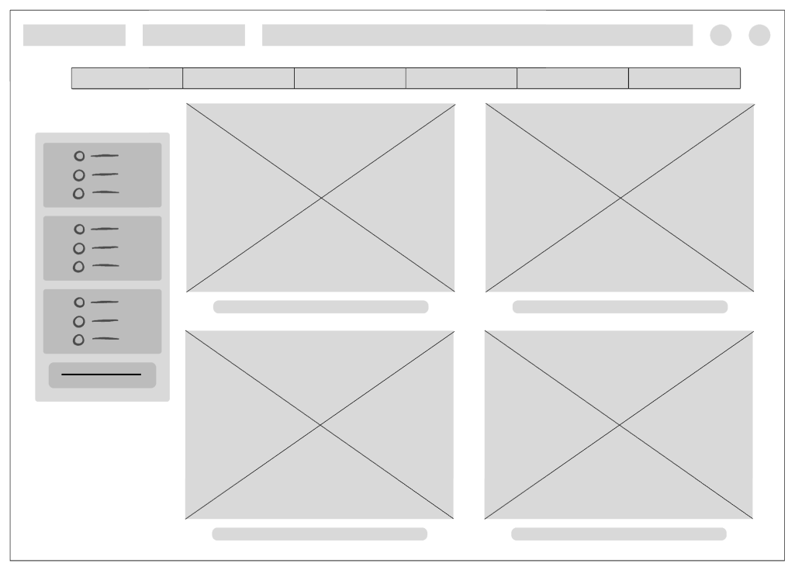
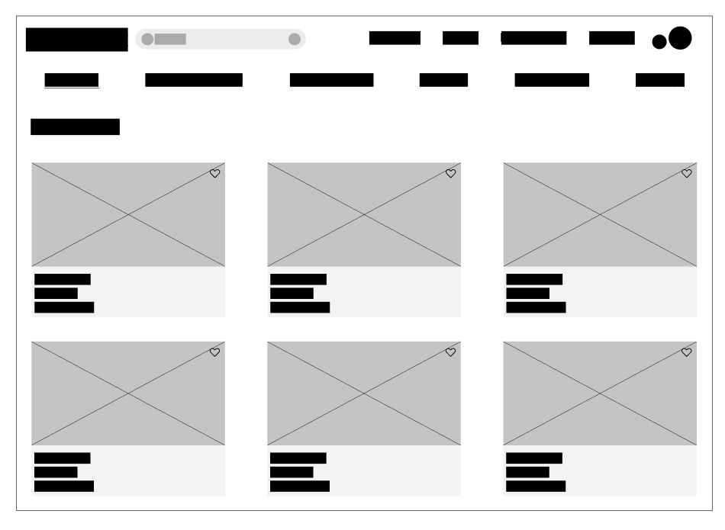
Early Sketches
Initial concepts developed through quick, low-fidelity wireframes to map out user journeys and establish the groundwork for a more intuitive housing search experience.

Slide 19






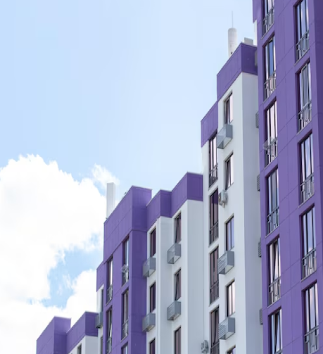


Style Guide
FONTS
MOOD BOARD
For our redesign we
used the following font:
TITLES:
INTER
HEADERS:
INTER
BODY COPY:
INTER
COLORS
#FFFFFF
#000000
#551A8B

Slide 20
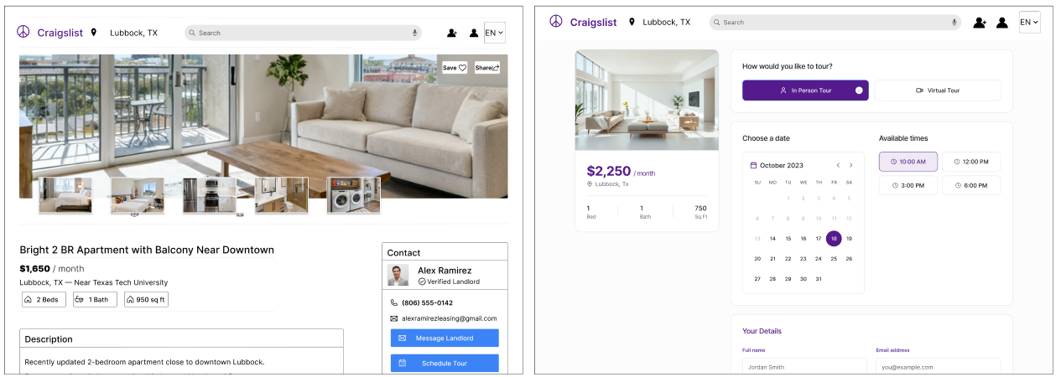
High Fidelity Screens
Detailed designs that refine layout and interaction patterns, bringing greater clarity and usability to the housing search experience.

Slide 21
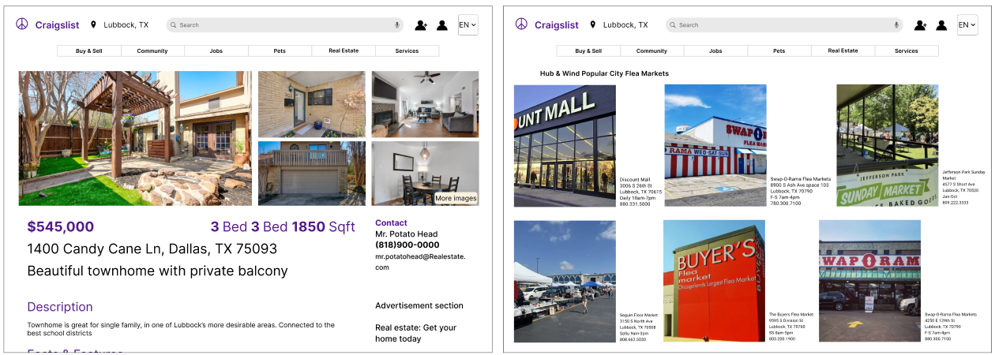

Slide 22
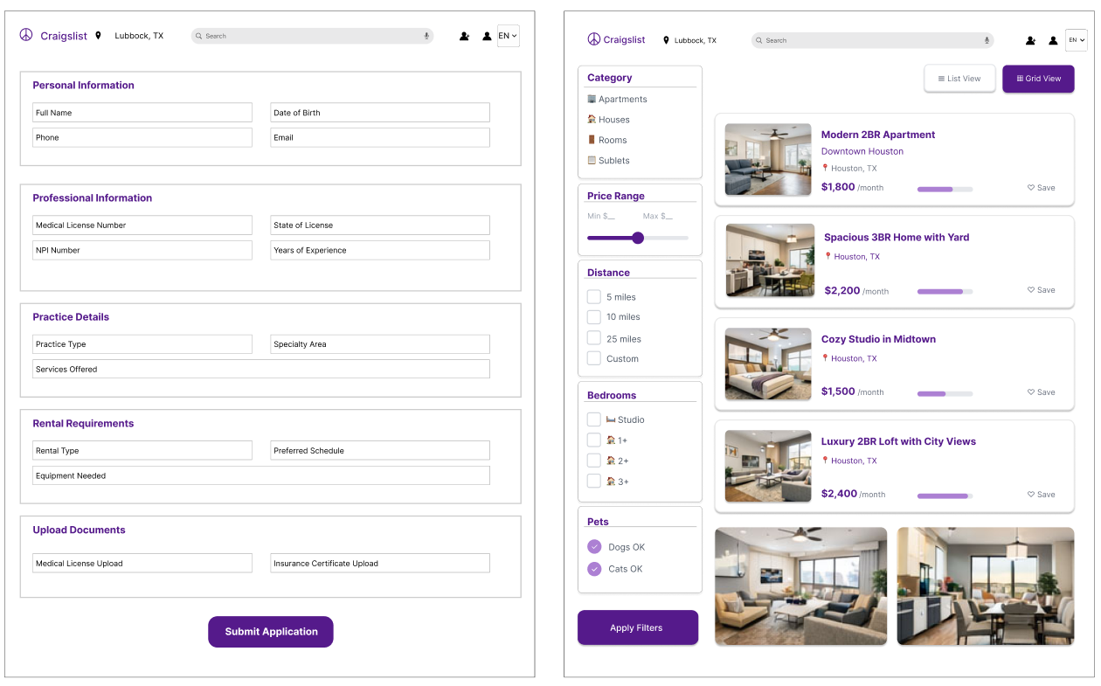

Slide 23
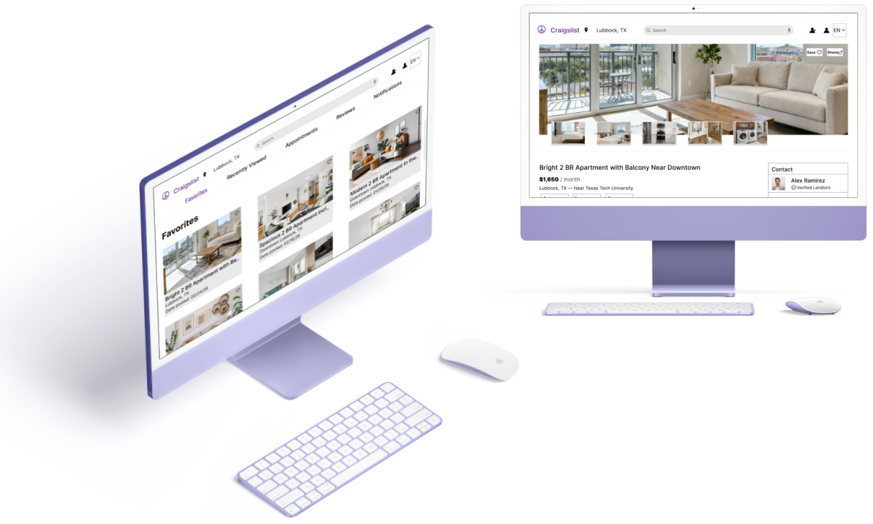
Final Iteration
A polished, high-fidelity redesign of Craigslist Housing with improved usability, visual clarity, and a more intuitive user experience.

Slide 24
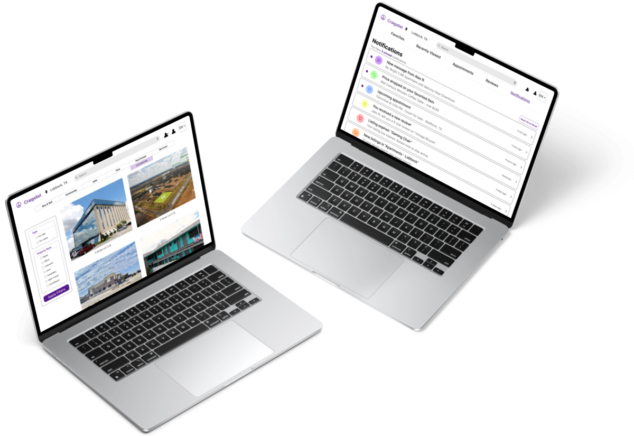
Click here to view the final iteration prototype in Figma

Slide 25
Next Steps
Expand & Improve Filters: Add advanced filtering options (school district, price, bedrooms/bathrooms, HOA, distance) to help users quickly find relevant listings.
Dynamic Neighborhood Insights: Integrate contextual data about neighborhoods (crime stats, walkability, school ratings, commute times) directly into listings to help users make informed decisions without leaving the platform.
Community-Driven Reviews & Ratings: Allow renters to rate and review landlords, buildings, or neighborhoods, building a reputation system that increases transparency and trust.
Optimize Listing Creation for Landlords: Streamline account setup, listing input, posting, and verification processes to reduce friction and errors.
Conduct Broader Usability Testing: Test flows with both renters and landlords to validate improvements, uncover pain points, and refine the overall experience.

Slide 26
Conclusion
Craigslist’s strength lies in its vast selection and real-time postings; a structured layout, standardized listings, and smarter navigation ensure users can access this breadth efficiently without feeling overwhelmed.
By improving filtering, listing clarity, and verification, Craigslist can transform its housing section from a chaotic marketplace into a trustworthy, easy-to-navigate platform for both renters and landlords.
A modern redesign considers the full ecosystem: helping renters find, evaluate, and act on listings while streamlining listing creation, posting, and verification for landlords, creating a seamless experience for all users.
Transforming the housing section with smarter filters, real-time notifications, trust signals, and contextual neighborhood insights stations Craigslist to compete with purpose-built real estate platforms while retaining its core identity as a broad, accessible marketplace.
A successful redesign positions Craigslist not just as a listing site, but as a central hub for local housing activity, informative, interactive, and responsive to evolving user needs.

Slide 27
Thank you for reading!

