Slide 1
Ariv
UX Case Study

Slide 2
The Problem
People often plan safe rides, but plans can fall through, and impaired users may struggle to find help quickly. This app offers a simple, reliable way to instantly connect with a trusted driver and get home safely.

Slide 3
Objectives & Goals
Create a fast, intuitive safety app that enables users to access a safe ride home with minimal effort.
Enable one-tap connection to trusted drivers, reducing cognitive load in urgent or impaired situations.
Reduce the likelihood of unsafe decisions by providing an immediate and reliable transportation solution.
Build user trust by delivering a consistent, dependable experience that prioritizes safety and ease of use.

Slide 4



The Process
Discover
Design
Competitor Analysis
User Interviews
Prototype Overview
Core Experience Screens
User Testing
Final Iteration
Define
User Persona
Customer Journey Map
User Flow

Slide 5
Discover
Competitive Research
& User Interviews

Slide 6
Competitor Analysis
SWOT Analysis
Strengths
Weaknesses
Ariv’s one-tap, emergency-first design provides fast access to trusted contacts through an automated support system, creating a reliable, low-cost safety solution for high-stress situations.
Ariv’s reliance on trusted contacts and group adoption can limit reliability and requires thoughtful setup to maintain a simple, effective experience.
Existing Safe Ride programs and services like Uber and Lyft offer alternatives to drunk driving, but often rely on outdated systems, paid rides, or unfamiliar drivers. Ariv improves on these solutions through instant one-tap access, trusted network support, and a design focused on high-stress situations.
Opportunities
Threats
Opportunities include modernizing outdated Safe Ride systems, expanding through partnerships and personal networks, and extending the one-tap emergency model to other high-risk situations.
Major threats include competition from Uber and Lyft, user forgetfulness in emergencies, and trust or liability concerns that could impact long-term adoption.

Slide 7
User Interviews
I interviewed four active military members and veterans about their experiences with drinking and finding safe transportation home, focusing on behaviors, challenges, and decision-making in high-risk situations.
Convenience & Simplicity
Users want a fast, effortless way to get home, especially when impaired, and often struggle with complex steps like coordinating rides or contacting multiple people.
“There’s a bunch of different inputs… before you actually order a ride… a one button type of thing would be kind of perfect.”
Unreliable or Changing Plans
Many users said plans often fall through, designated drivers drink, rides are unavailable, or situations change, forcing unsafe or inconvenient alternatives.
“We would have a DD, and then the DD would get plastered drunk.”
Barriers to Asking for Help
Even when they need help, users often hesitate due to embarrassment or not wanting to bother others, leading to delays or risky choices.
“I just don’t want to bother them… it’s always really late at night.”

Slide 8
Define
Persona,
Customer Journey Map,
& User Flow

Slide 9

User Persona
Needs and motivations
Emily values efficiency, simplicity, and reliability in high-stress situations. She prefers tools that minimize steps and make safe decisions easy to act on in the moment.
Pain points
Emily gets frustrated with complex apps and multi-step processes in urgent situations. She needs quick, reliable access without relying on plans that may fall through.
Emily Chen
Emily Chen is a 27-year-old U.S. Air Force Cyber Operations Specialist with an information systems background. Tech-savvy and social, she values planning ahead but needs a reliable way to stay safe when plans change.
How we can help
Ariv gives Emily a fast, one-tap way to connect with a trusted driver, removing the need to search or make decisions in critical moments and ensuring a reliable backup to get home safely.

Slide 10

Emily Chen
“When I’m in a situation where I shouldn’t be driving, I don’t want to think through a bunch of steps. I just want something quick and reliable that helps me get home safely.”
Goals
Get home safely without needing to think through complicated steps.
Use fast, reliable tools that work in high-stress or impaired situations.
Bio
Emily is a U.S. Air Force Cyber Operations Specialist who works in network security and is highly comfortable with digital tools. She values efficiency, enjoys socializing and exploring new places, and prioritizes safety even when plans change unexpectedly.
Motivations
Values personal safety and the safety of her peers.
Prefers simple, tech-driven solutions that save time and effort.
Frustrations
Age
27
Having to search for contact info or options when she’s already stressed.
Apps that require too many steps or decisions in urgent moments.
Occupation
Cyber Operations Specialist, USAF
Personality
Status
Single
Extrovert
Introvert
Tech skills
Education
Bachelor’s Degree
Spontaneous
Planner
Mobile
88%
Location
Norfolk, Virginia
Tablet
75%
Archetype
Tech Lover
Collaborative
Independent
Desktop
88%

Slide 11
Customer Journey Map
Outlining Emily’s Ideal User Experience
Scenario:
Emily is an active-duty service member who goes out with friends on the weekend to unwind. While she doesn’t always plan to drink heavily, her nights can be unpredictable, and transportation plans often change. When she realizes she shouldn’t drive, she needs a fast, reliable, and low-effort way to get home safely without relying on complicated apps or bothering others.
Expectations:
● Ability to request a safe ride instantly with a simple one-tap action.
● No need to input details or make decisions while impaired.
● Quick confirmation that a trusted and reliable driver is on the way.
● Clear, automatic updates on pickup status without requiring interaction.
● Confidence that the driver is safe, verified, and able to reach her (ex: base access).
● A dependable solution when original plans (DD, Uber, friends) fall through.

Slide 12
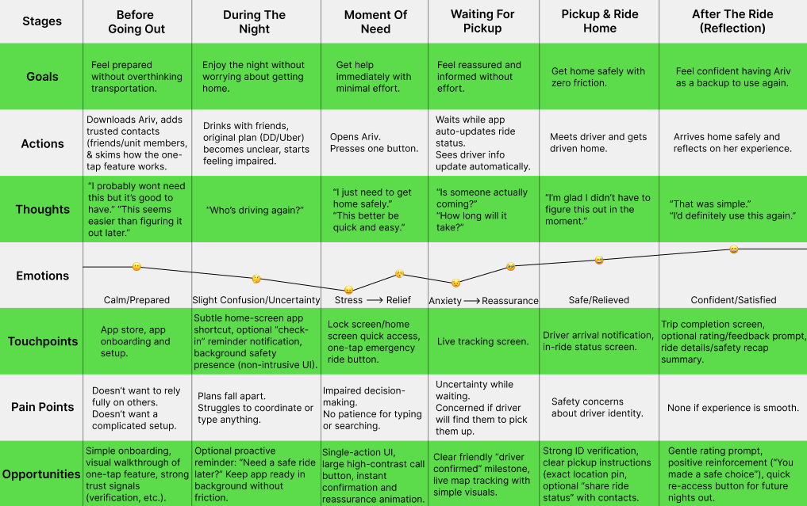

Slide 13
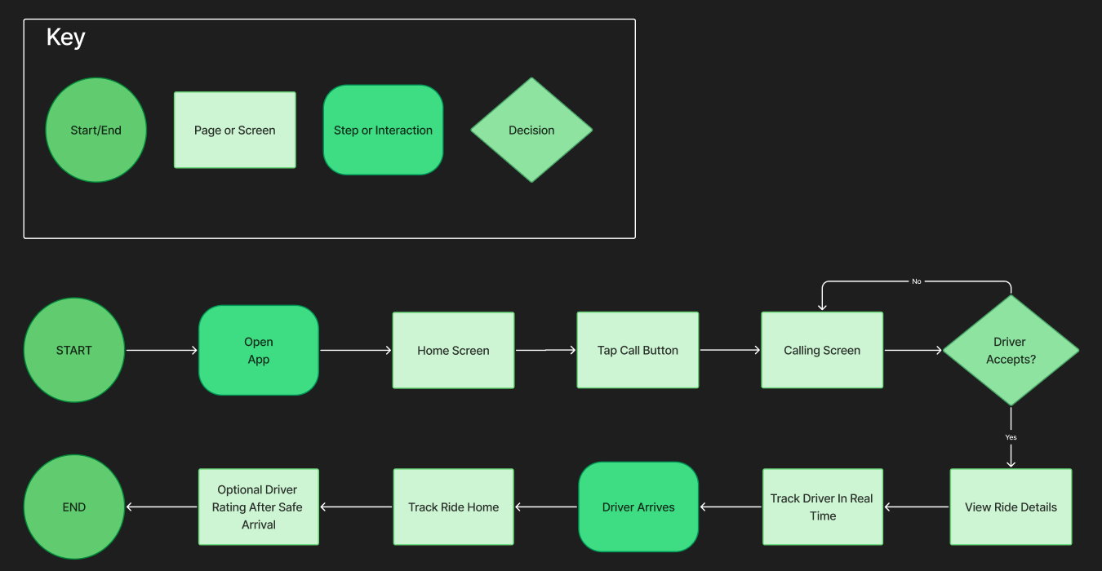
User Flow
Mapping the end-to-end experience for users, from recognizing the need for a safe ride to requesting help, connecting with a trusted driver, and safely arriving home, ensuring speed, clarity, and trust throughout the process.

Slide 14
Design
Prototype Overview,
Primary Screens,
Prototype Testing,
& Final Design

Slide 15
High-Fidelity Prototype
This prototype focuses on a fast, simple one-tap flow for high-stress situations, enabling users to quickly request a safe ride with minimal effort and no navigation or decision-making.
Each step is streamlined for clarity, from requesting a ride to tracking arrival. Key details like driver info, ETA, and live location are surfaced to build trust and reduce uncertainty while waiting.
The design was tested with impaired participants in controlled settings, and insights from these sessions directly shaped a more intuitive, responsive, and reliable experience.
Click here to view the high fidelity prototype in Figma

Slide 16
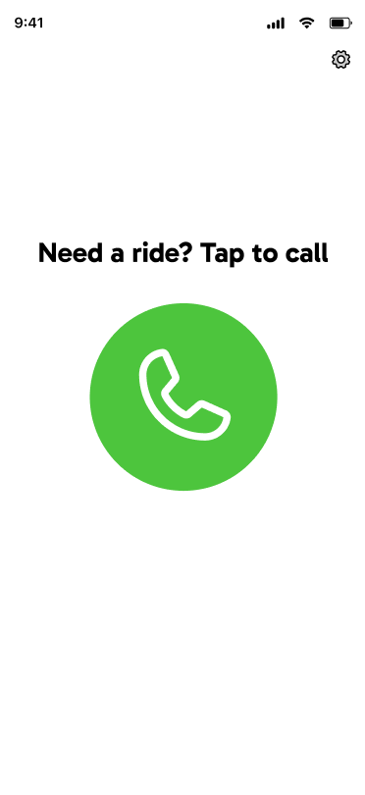
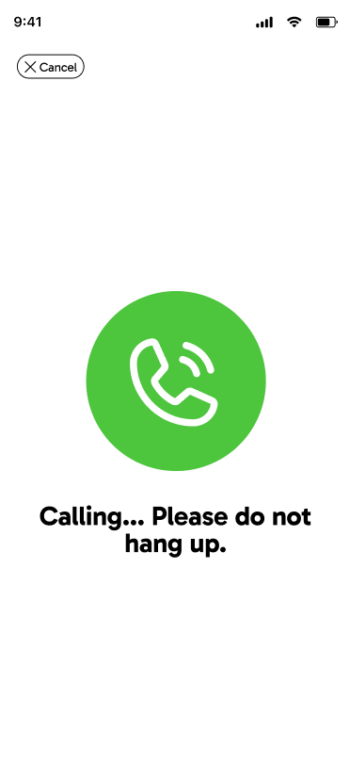
Requesting a Ride
Users quickly request a ride using the one-tap call button and are connected to a driver. This step emphasizes speed, simplicity, and ease of use.

Slide 17
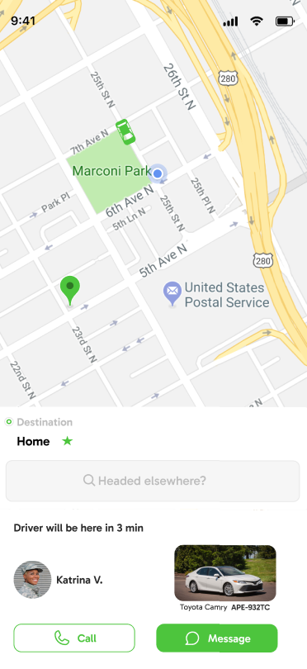
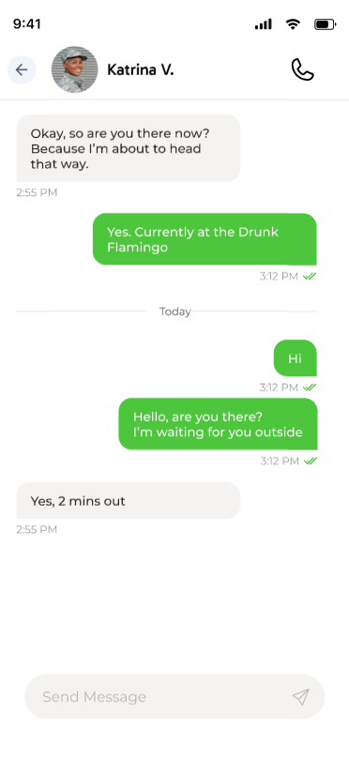
Driver Match & Communication
Once a driver is assigned, users can view ETA, driver details, and communicate directly. This stage builds trust and keeps users informed while they wait.

Slide 18
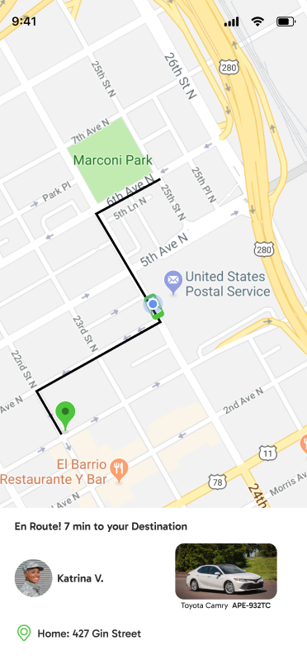
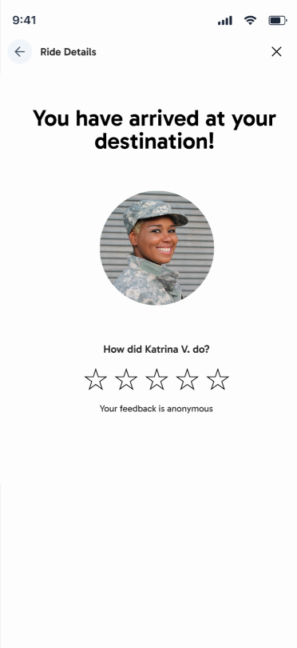
Ride Tracking & Completion
Users track their route home in real time and optionally provide feedback after arrival, reinforcing transparency, safety, and a clear end to the experience.

Slide 19
User Testing
Using a high-fidelity prototype, I tested usability in a controlled setting where participants had consumed alcohol safely beforehand. The study evaluated how easily users could request a ride and understand the experience while impaired.
Task 1: Request a Safe Ride
Task 2: Understand the Waiting Experience
Key Takeaways
All participants successfully requested a ride using the one-tap button, even while impaired, confirming the flow is intuitive, fast, and easy to understand.
Participants were able to understand what was happening through real-time updates like live tracking, ETAs, and driver details, which helped the experience feel transparent, clear, and trustworthy.
The app proved intuitive and fast, with participants easily requesting rides and feeling confident throughout. Clear tracking and driver details built trust, and the one-tap flow reduced friction in high-stress situations.

Slide 20
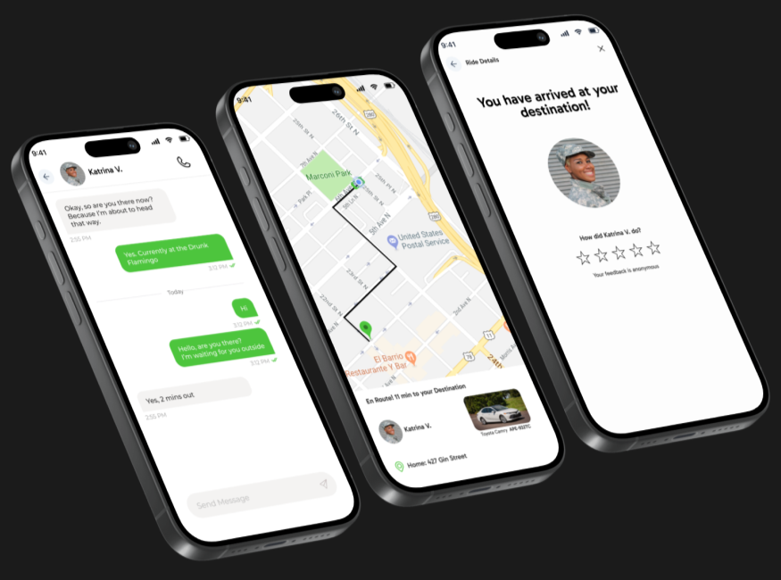

Final Iteration
A curated set of key screens showing the end-to-end flow, from requesting a ride to arrival, with a focus on clarity, safety, and ease of use.

Slide 21
Next Steps
Refine the one-tap flow by clearly communicating that rides are donation-supported, eliminating uncertainty while reinforcing the app’s mission-driven model.
Expand testing to include a wider range of real-world, high-stress scenarios to ensure the app performs reliably when users need it most.
Iterate on trust-building features such as driver details, vehicle identification, and live tracking to further strengthen safety and confidence.
Polish the interface to make critical information even more visible and easy to understand in urgent situations.
Continue gathering user feedback to ensure the experience remains intuitive, fast, and dependable when it matters most.

Slide 22
Conclusion
The core flow, requesting a ride with a single tap, was intuitive, fast, and easy to complete, even in a simulated high-pressure situation.
Participants appreciated how quickly they were connected to a driver without needing to input information or make additional decisions.
Real-time tracking, driver details, and messaging features increased trust and helped users feel informed and comfortable while waiting.
The app reduces friction in moments of impairment by eliminating common pain points like typing locations, coordinating rides, or searching for options.
Overall, the usability test confirmed the experience is simple, reliable, and well-aligned with how users need to get home safely in real-world situations.

Slide 23
Thank you for reading!

