Slide 1
Building a
Recipe App
UX Case Study

Slide 2
The Problem
Company
Context
Problem statement
People buy groceries and cook meals regularly, but many struggle to decide what to cook with the ingredients they already have. The goal of this app is to help users find recipes based on available ingredients, reuse leftovers, and plan meals in a way that reduces food waste and saves both time and money.

Slide 3
Objectives & Goals
Create an easy-to-use recipe application that helps users feel confident deciding what to cook with the ingredients they already have.
Allow users to quickly find recipes based on what is available in their kitchen.
Help users reuse leftovers in simple and creative ways instead of wasting food.
Support users in saving recipes and planning meals to make cooking less stressful and more efficient.

Slide 4
The Process
Discover
Define
Design
Direct Competitor Analysis
Indirect Competitor Analysis
User Interviews
User Persona
Customer Journey Map
User Flow
Early Sketches
Low Fidelity Screens
Medium Fidelity Screens
High Fidelity Screens
User Testing
Final Iteration

Slide 5
Discover
Competitive Research
& User Interviews

Slide 6
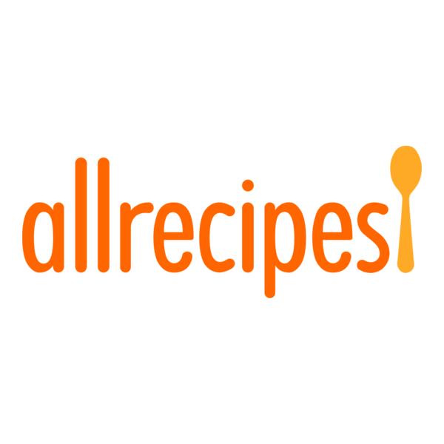
Direct Competitor Analysis
Allrecipes
“Home cooks are our heroes—it's as simple as that.”
Features:
● Large recipe database with ingredient-based search.
● Trusted brand with strong community support and reviews.
● Mobile app with visually appealing recipe layouts.
● Supports personalization and inspires cooking through community engagement.
Issues:
● Ads clutter the interface and can distract users.
● Navigation can feel overwhelming due to content-heavy screens.
● Limited integration with users’ own pantry or ingredient tracking.
● Large amount of content can reduce focus and decision efficiency.

Slide 7

Indirect Competitor Analysis
Instacart
“Groceries delivered in an hour.”
Features:
● Recipes link directly to the Instacart shopping platform.
● Users can quickly add all recipe ingredients to their cart.
● Convenient grocery delivery or pickup is integrated.
● Smooth, intuitive UX for shopping and checkout.
Issues:
● Not designed for cooking inspiration or recipe discovery.
● Lacks focus on “use what you have” or leftover-based meals.
● Limited tools for meal planning or organizing weekly cooking.
● Recipe integration is secondary to shopping; saving recipes isn’t supported.

Slide 8
User Interviews
“It’d be a lot easier if I could just plug in what I had, and it would just bring things to me rather than having to… figure it out on my own.”
I interviewed two participants ages 25-55 about their experiences with recipe apps as well as their experiences of cooking with limited ingredients.
Key Findings
● Convenience
Users want a fast, easy-to-use tool that lets them find recipes based on what ingredients they already have without spending extra time searching or guessing.
“Video recipes are fun, but they don’t tell you the exact amounts… it’d be way easier if someone just gave the measurements.”
● Accuracy & Clarity
Participants are frustrated by incomplete or unclear recipes (especially on social media) and want precise instructions, measurements, and ingredient lists to cook successfully.
● Waste Reduction & Flexibility
Users want help repurposing leftovers and working with what they already have in their pantry or fridge, reducing waste while still being able to make practical and enjoyable meals.
“Sometimes it ends up going to waste because it’s just, you know, such a small amount of something… I just have to toss it.”

Slide 9
Define
Persona,
Customer Journey Map,
& User Flow

Slide 10
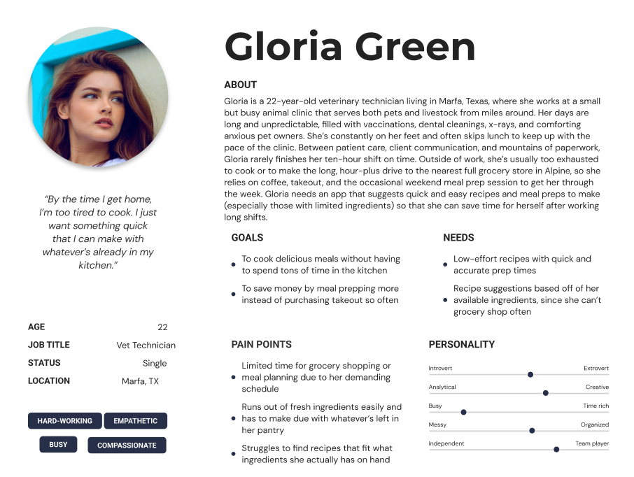
User Persona

Slide 11
Customer Journey Map
Outlining Gloria’s Ideal User Experience
Scenario:
Gloria is a busy professional who wants to prep her meals for the week so she can eat healthier, save time, and avoid last-minute decisions about dinner. She uses a recipe app to find meal ideas that match the ingredients she already has at home.
Expectations:
● Ability to quickly find recipes that match the ingredients she has.
● Guidance for manageable prep steps with time estimates.
● Clear cooking instructions with alternate flavors or remix suggestions.
● Assistance in storing meals, labeling, and tracking freshness.
● Easy access to prepped meals during the week with reminders to prevent waste.
● Insights and prompts at the end of the week to improve future meal planning.

Slide 12
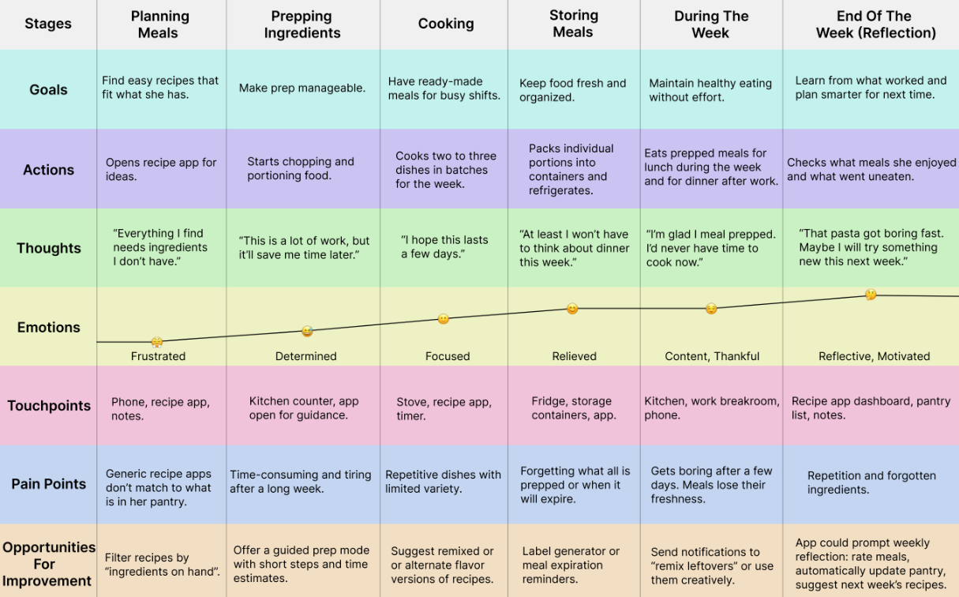

Slide 13
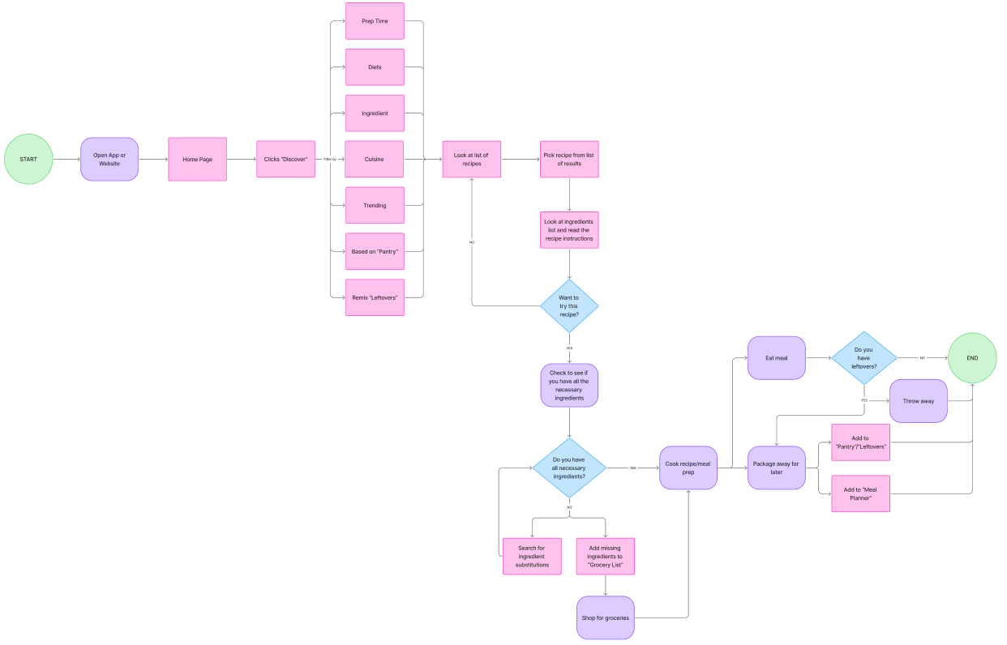
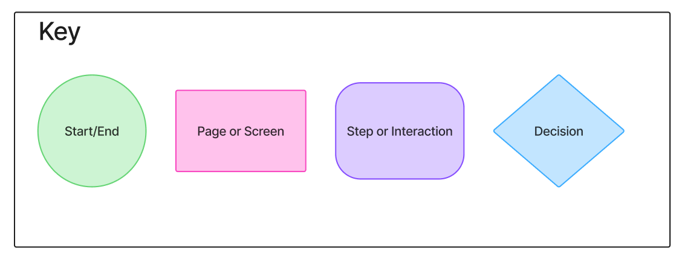
User Flow
Mapping out the core experience of discovering,
preparing, and managing meals in flow form.

Slide 14
Design
Early Sketches, Wireframes,
Prototype Testing,
& Final Design

Slide 15
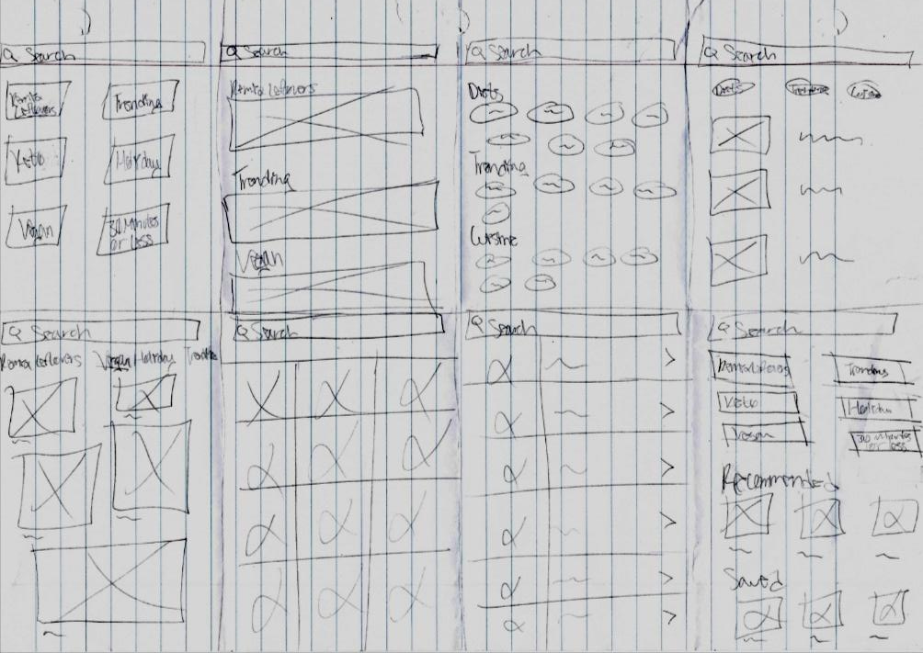
Early Sketches
I used the Crazy 8s exercise to quickly generate and compare multiple homepage layout ideas for my recipe app. This helped me explore different ways information could be prioritized and accessed at a glance.
The concepts focused on placing a prominent search bar at the top of the screen, allowing users to immediately search by ingredients. Suggested recipes were also a key element giving users quick inspiration based on what they already have available.
Additional ideas included filters for dietary preferences, leftover-based recipe suggestions, and access to saved or recently viewed recipes to support faster decision-making.

Slide 16
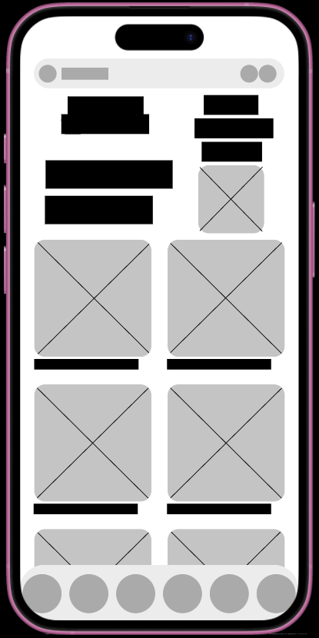
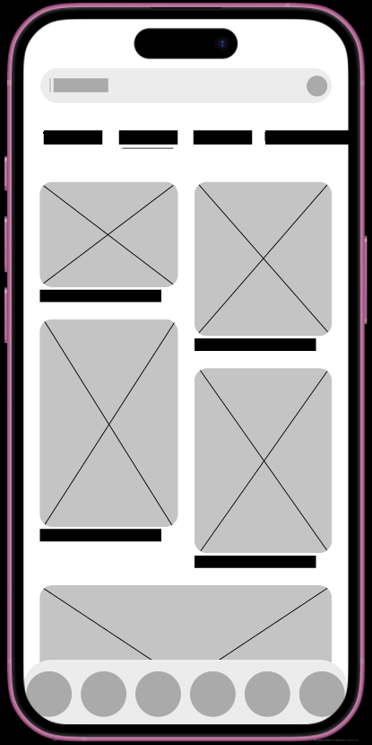
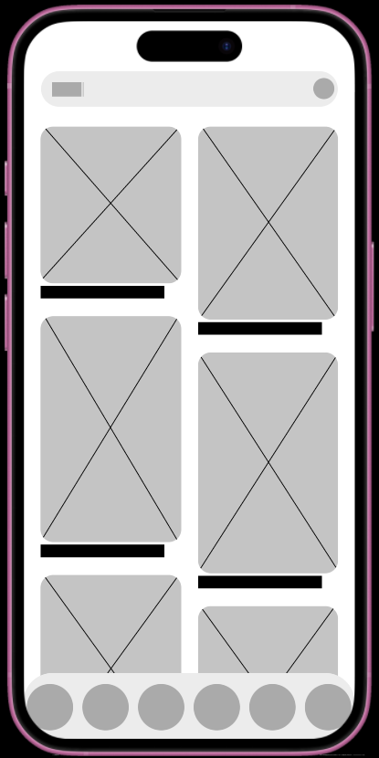
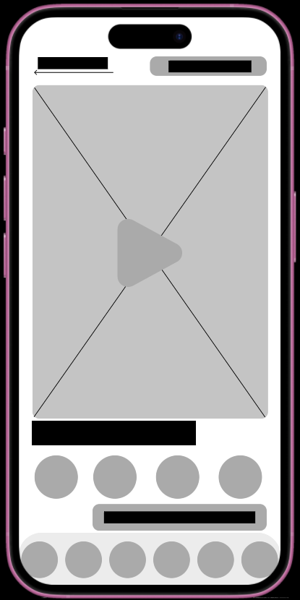
Low Fidelity Screens
Early rapid wireframes used to explore core
user flows and establish the experience foundation

Slide 17
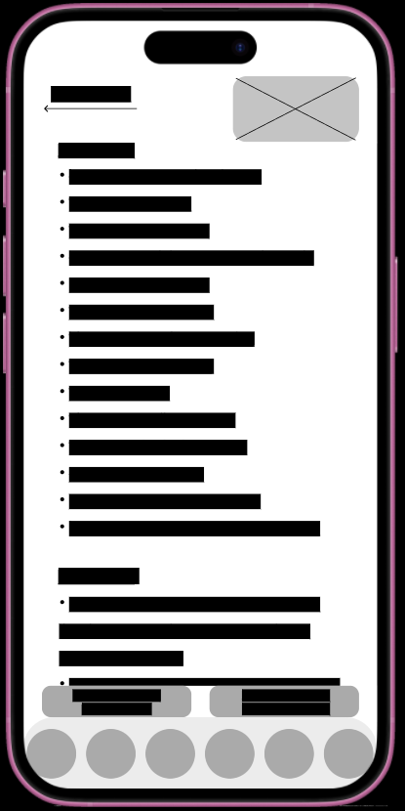
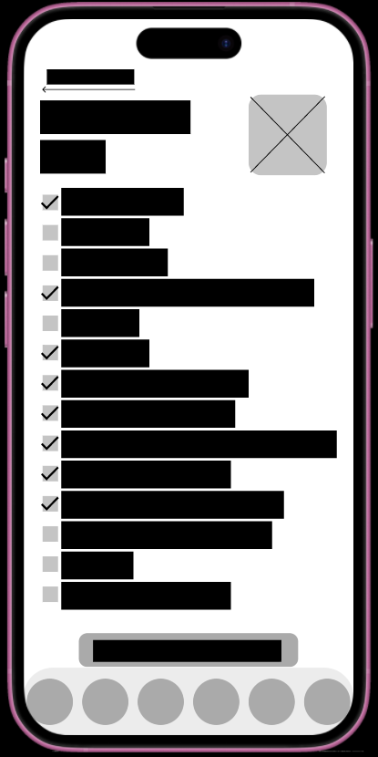
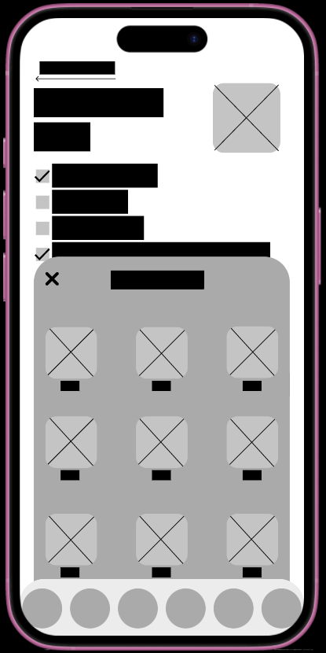
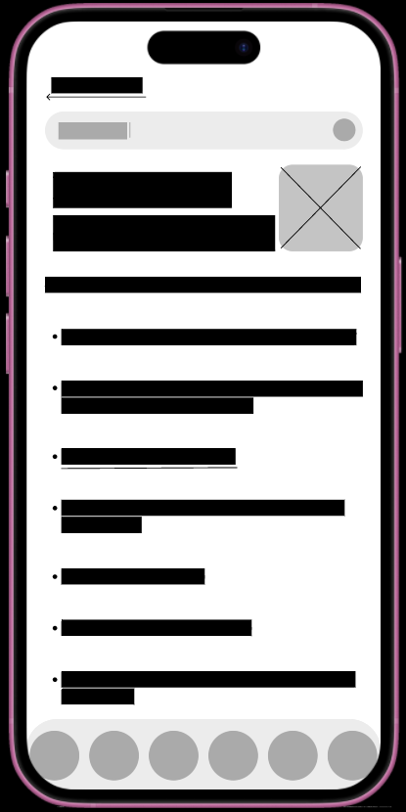
Click here to view the low fidelity prototype in Figma

Slide 18
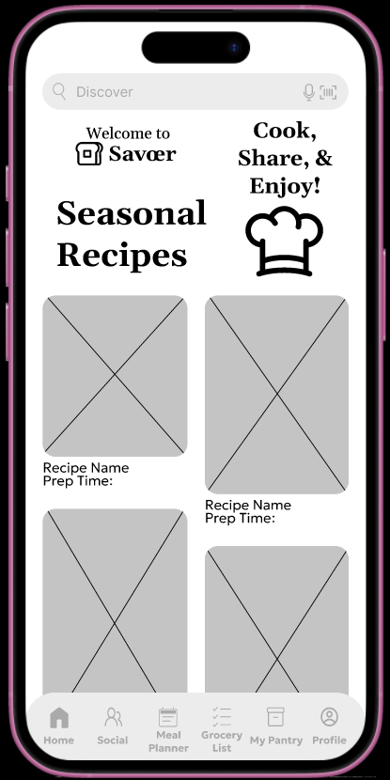
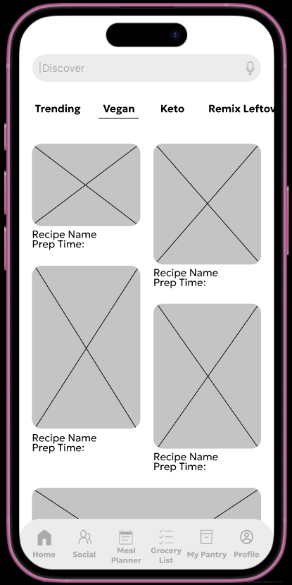
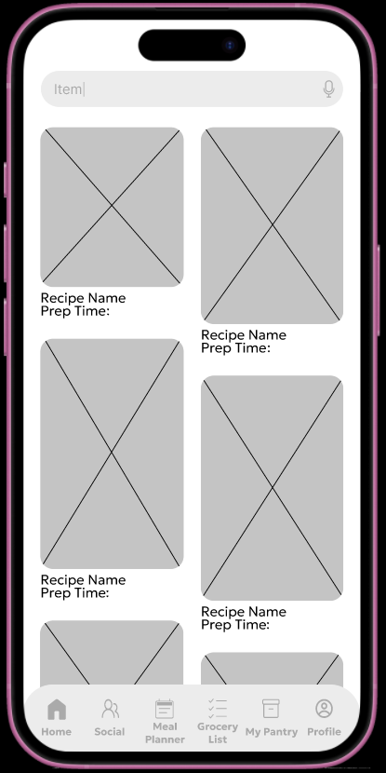
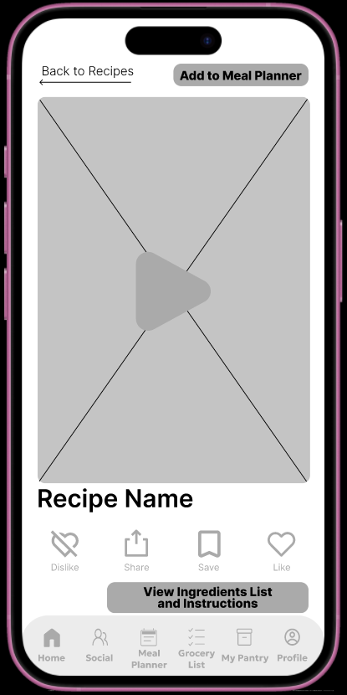
Medium Fidelity Screens
Evolving early concepts into clearer,
more defined user flows

Slide 19
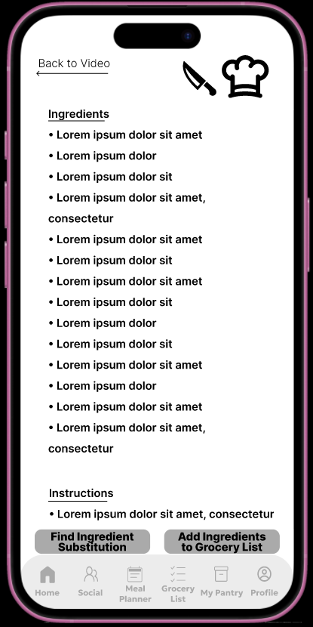
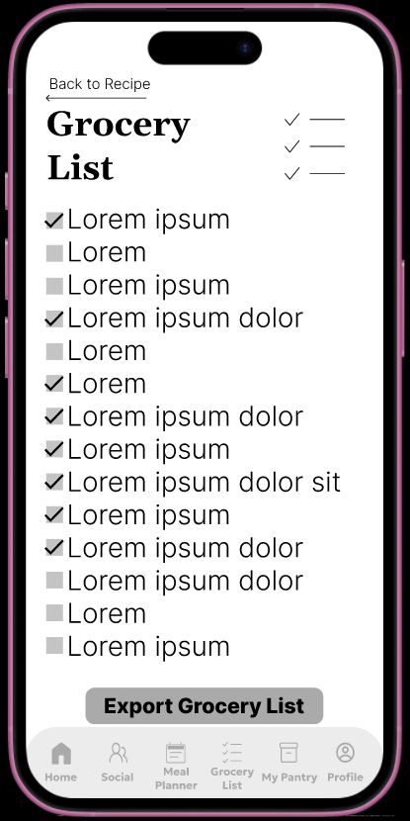
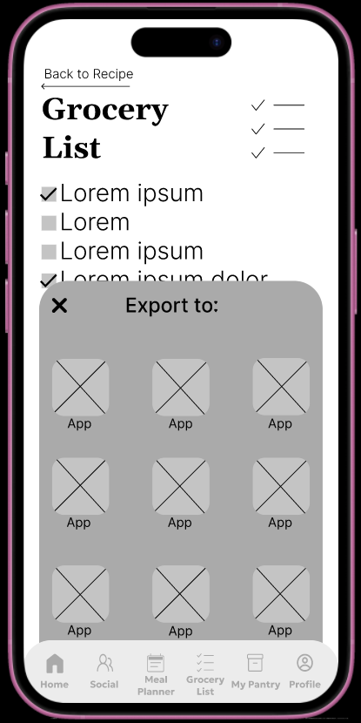
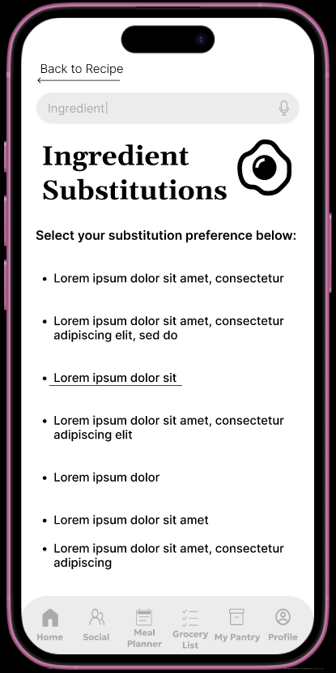
Click here to view the medium fidelity prototype in Figma

Slide 20
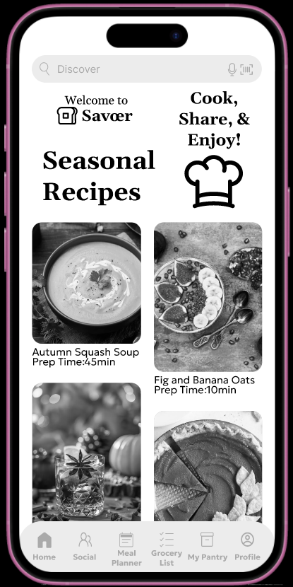
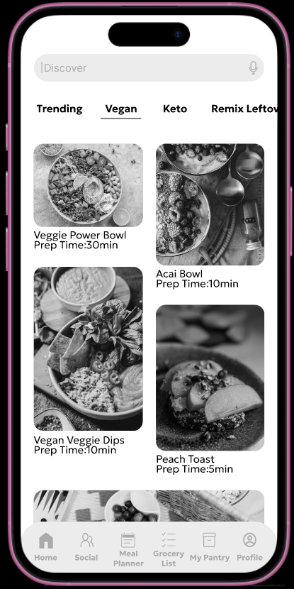
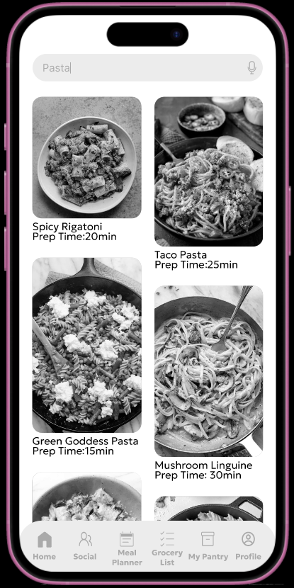
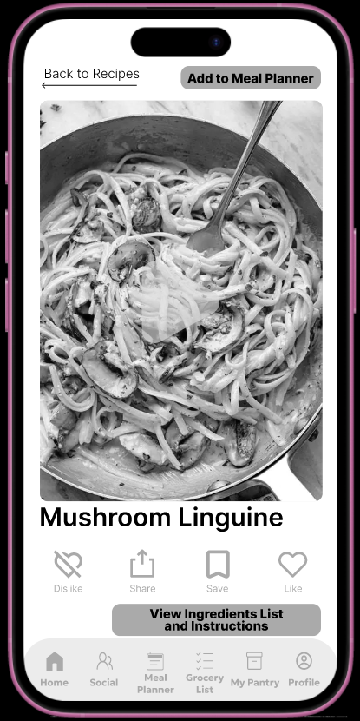
High Fidelity Screens
Nearly finalized screens focused on refining
structure and interactions prior to visual styling

Slide 21
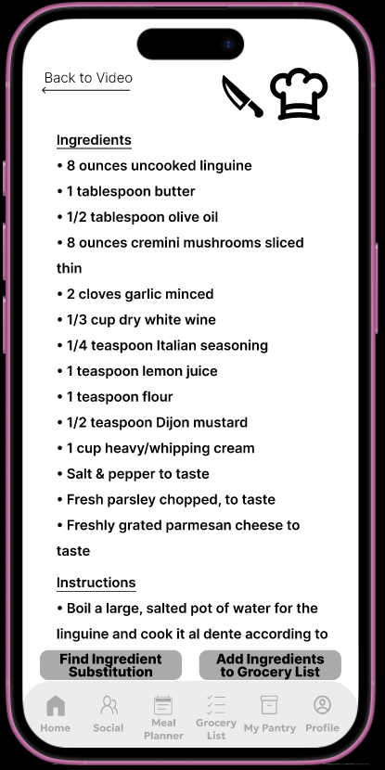
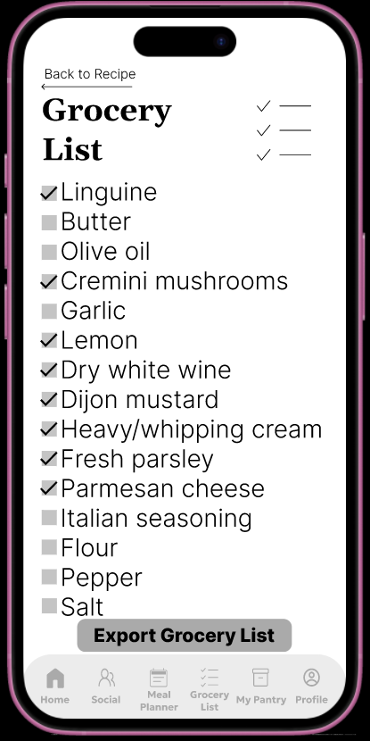
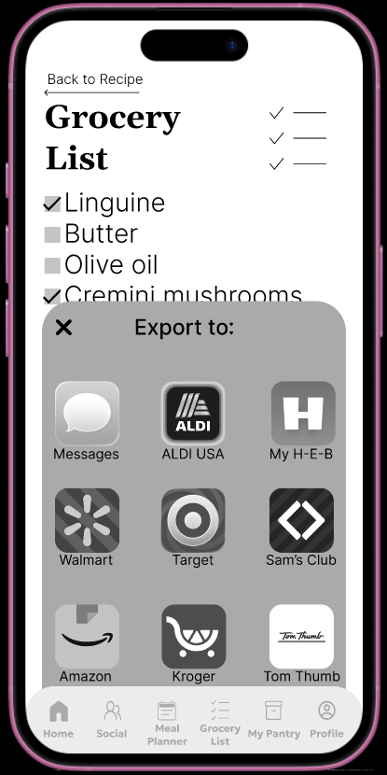
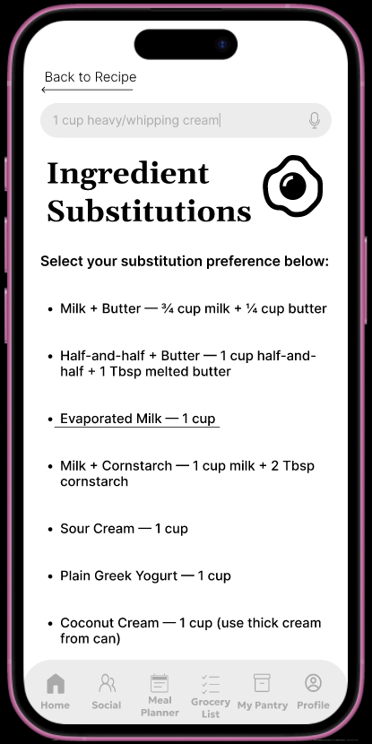
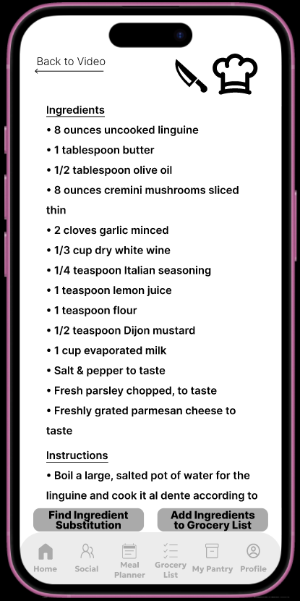
Click here to view the high fidelity prototype in Figma

Slide 22
User Testing
Using a high fidelity greyscale prototype, I tested the core flows of the app: finding recipes, managing missing ingredients, and creating a grocery list.
Task 1: Find a Recipe Using Available Ingredients
All participants successfully searched for and selected recipes using ingredients they already had. The process felt intuitive, fast, and easy to browse.
Task 2: Find an Ingredient Substitution
Testers easily discovered the substitution feature from the ingredients list. Suggestions were clear, practical, and inspired confidence while cooking.
Task 3: Add Recipe Ingredients to a Grocery List
Participants added ingredients to a grocery list without confusion and appreciated being able to select only what they needed.
Key Takeaways
The app’s primary flows were clear, discoverable, and highly usable, allowing users to move through tasks with little to no friction. Participants felt confident finding recipes, locating ingredient substitutions, and adding items to their grocery list using features that were easy to find and understand.

Slide 23
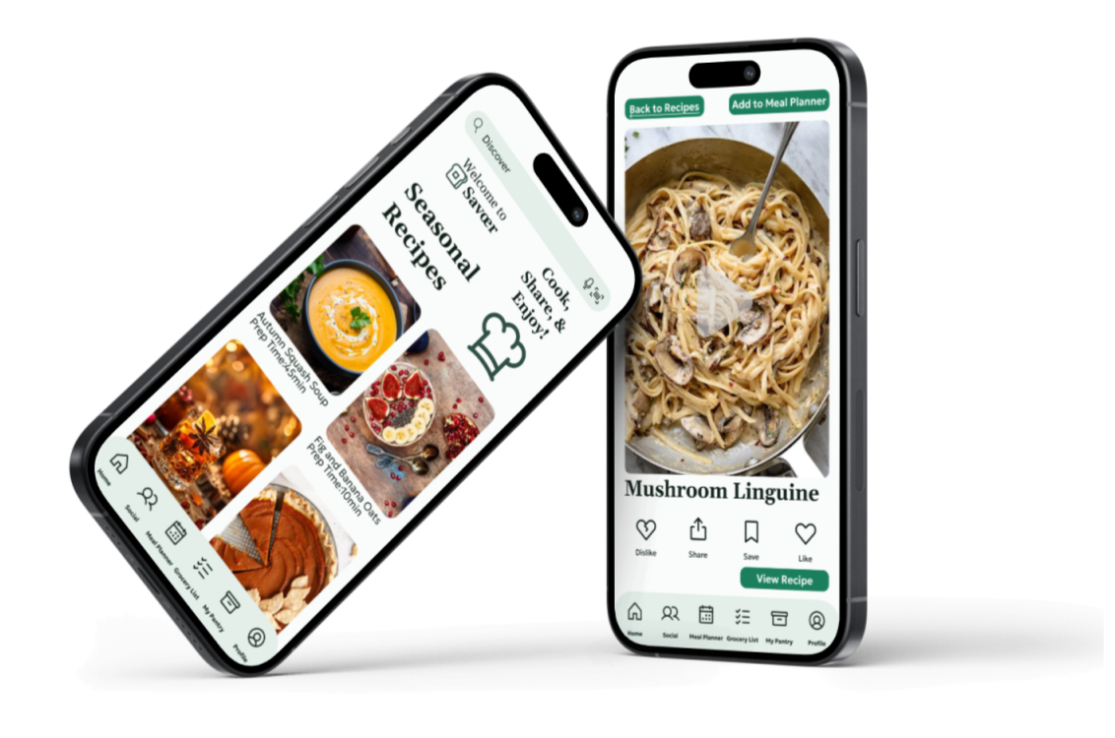
Final Iteration
Fully realized designs applying final visual styling,
color, and branding to deliver the complete user experience

Slide 24
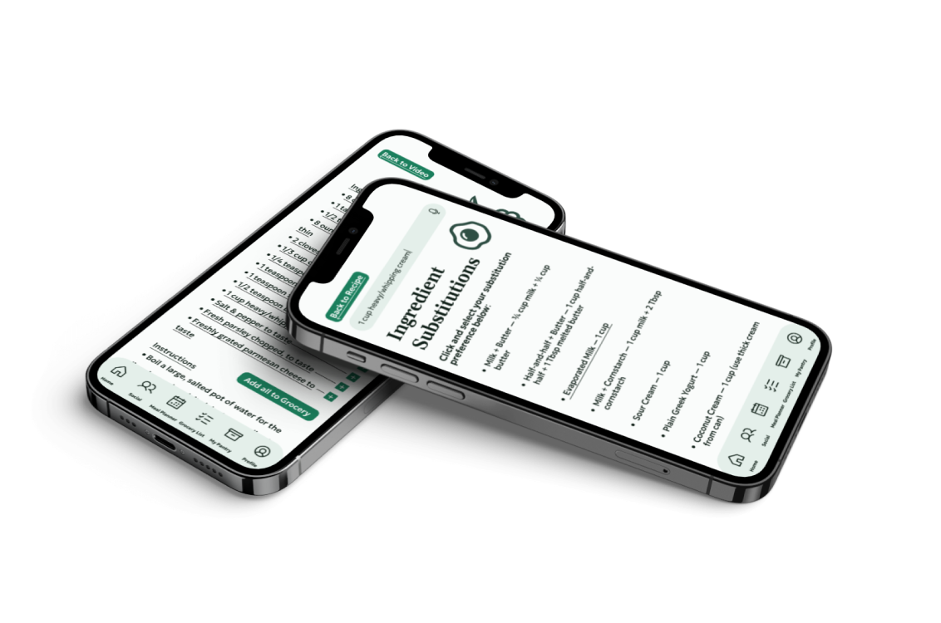
Click here to view the final iteration prototype in Figma

Slide 25
Next Steps
Enhance substitutions: Add guidance or visual cues for less familiar ingredients to help users feel confident adapting recipes.
Broaden testing: Conduct additional usability sessions to validate core flows across a wider audience.
Iterate features: Explore adding a meal planner, favorites, and recipe filters to support flexible and personalized meal preparation.
Polish visuals: Refine UI elements, ingredient imagery, and interaction details for clarity and ease of use.
Ongoing research: Gather continual user feedback to ensure the app remains practical and intuitive in real-world cooking scenarios.

Slide 26
Conclusion
The core flows, searching for recipes with available ingredients, finding substitutions, and adding items to a grocery list, were intuitive and easy to complete.
Participants appreciated quickly discovering recipes without needing to plan ahead or shop for missing ingredients.
Ingredient substitutions and grocery list features were practical, clear, and gave users confidence while cooking.
The app supports flexible, real-world cooking, allowing users to adapt recipes based on what they already have.
Overall, the usability test confirmed the experience is engaging, efficient, and closely matches how users approach cooking at home.

Slide 27
Thank you for reading!

